Slide 1
Covidien Gateway Prototype Project Status and Plan
January 9, 2012
By Shahid N. Shah

Slide 2
Gateway prototype project overview
Define and design general technical approach
Architectural Design and Planning
Define all major components of the architecture
Research available open-source solutions for each of the major components
Perform due diligence on each open source solution based on stability, support, and long-term maintenance capabilities
Install all major architectural components and subsystems as a proof of concept
Create a benchmarking, testing and quality assurance strategy/plan
Create or run code to conduct benchmarking of major architectural components
Create scalability test approach

Slide 3
Common Design Requirements
Alerting and annunciation
Device / system reliability and general monitoring
Device communication
Patient acuity reports
Pushing data to other systems
Capturing data from other systems
Display multiple of same parameter
Tunable sampling rates
ADT interface
Tie into hospital IT security
 Courtesy of Dr. Chris Carnes

Slide 4
Ensure testability and validation
Encourage reusable testing and validation
Create system abstractions (simulations, etc.)
Create component abstractions (devices, etc.)
Focus on data-oriented test scenarios
Create data generators, loggers, and initiators for test scenarios
Encourage automated testing from day 1
Start using and building simulators for ecosystem validation

Slide 5


Next Gen Gateway Architecture
Patient Manager
Secure Messaging
Social Networks
HCP Directories
Target multiple devices like PC, SmartPhone, Tablet, Voice
HIE/NHIN Integration
EHR Integration
NLP & Patterns
Med Device Integration
Single sign on (LDAP, SAML)
Mobility Stack
Web Application Stack
Med Device Tethering
Data Integration Stack
Content Management System
Biz Intel
Integration
Analytics
App Store
EHR Modules
Alerting
HIPAA Encryption & RBAC
EII
Metadata
Rules Engine
Security & Auditing
Themes
Documents
Dashboards
Gateway
Data Mining
Notifications
IM / E-mail
Forms
Reporting
Provisioning & Auditing
ETL
OLAP
Process Mgmt
Legacy App Connectivity
Secure, HIPAA-Compliant, Web Server
Enterprise Service Bus
HL7
X.12
CCR
DDS
Data Services and Persistence Stack
Secure, MU- and HIPAA-Compliant, Clinical Data Repository (CDR) and Master Patient Index (MPI)
Relational Database
Graph DB (RDF)
Content Repository
Taxonomy
Full Text Search
LDAP
On-Premise Appliance or Cloud Deployment
 As defined by Netspective Medigy Platform

Slide 6
Gateway prototype connectivity
OMG Data Distribution Service for Real-Time Systems (DDS)
Custom REST or SOAP Web Services
Advanced Message Queuing Protocol (AMQP)
Extensible Messaging and Presence Protocol (XMPP)
Simple Network Management Protocol (SNMP)
Minimal Lower Layer Protocol (MLLP) with HL7
Wireless Communication Transfer Protocol (WCTP)
IEEE 11073 (x73)
X.12 over TCP/IP

Slide 7
The prototype’s components
Real Device (test data)
Gateway Prototype (Virtual Machine)
Simulated Corporate Cloud
Simulated Network
Simulated Hospital Systems
Simulated Device (test data)
REST
DDS
Wired
DDS
HL7
X.12

Slide 8
Assuming real-time protocol requirement
Non-realtime (millisecond resolution with best-effort delivery)
Non-deterministic
Use at server
Use in the cloud
Realtime (microsecond resolution with guarantees)
Deterministic
Use at server
Use in the cloud
Use inside devices

Slide 9
Assuming publish / subscribe
Hub/Spoke – high coupling
Publish/Subscribe – low coupling
Gateway Alarm Handler, Data Store
Device
Device
EHR / HIS
Remote UI
Gateway
Med Device
Med Device
Data Store
EHR / HIS
Remote UI
Alarm Handler
Cloud / EHR / HIS
iOS
Android
Server or
Phone
PC App
Mobile App
Any others
Independent DB
Supports one-to-one, one-to-many, many-to-one, and many-to-many communications

Slide 10
Technical Deliverables
Gateway platform as virtual machine
Simulation data generator (test data)
Simulation commands controller
Simulation data publisher for pulse ox (“pulseox”), blood pressure (“bp”), and temperature (“temp”) data
Simulation from multiple machines
Category based logging for publishers and subscribers
Real data listeners and event handlers that respond to either actual device or simulated data
Echo data to console
Echo data to web page (graphs)
Complex event processing
Persistence

Slide 11
Schedule Overview
9/1/11
Define
10/1/11
10/1/11
Design
11/1/11
11/1/11
Build
12/1/11
12/1/11
Test
1/1/12
1/1/12
Refine
2/1/12
Finalize technical approach
10/1/11
Define persistence strategy
10/24/11
Benchmarking & evaluation
11/15/11
Start Design
Design review
Scalability evaluation
9/1/11
11/1/11
12/1/11
Today
' 11
Sep 2011
Oct
Nov
Dec
Jan 2012
Feb
' 12
Build VM
Choose IDLs
Create test plan
Engineering Review
Executive Review
9/12/11
10/14/11
12/1/11
1/1/12
2/1/12

Slide 12
Prototype base platform
VMware Server 4.1 ESXi Hypervisor
VMware Virtual Machine (“the gateway”)
Ubuntu 10 64bit
OpenSplice HDE Release V5.4 (DDS)
SimpleDDS Library (DDS framework)
Boost Library (messaging framework)
MongoDB v2.0 (database)
Mongo cxx driver v1.8 (database driver)
Log4cpp-v1.0 (for logging)

Slide 13
Simulated messages IDL
struct DeviceStatus
{
string deviceDomain;
string deviceId;
string deviceStatus;
}
struct BloodPressure
{
string deviceDomain;
string deviceID;
long timeOfMeasurement;
short systolicPressure;
short diastolicPressure;
short pulseRatePerMinute;
}
struct PulseOximeter
{
string deviceDomain;
string deviceID;
long timeOfMeasurement;
short SPO2;
short pulseRatePerMinute;
}
struct Temperature
{
string deviceDomain;
string deviceID;
long timeOfMeasurement;
short temp;
}

Slide 14
Simulation data generator
Generates the random data for Pulse-ox, Blood Pressure and temperature as per the structure defined in the previous slide.
Has some pre-defined constraints to generate random data. (example systolic random data between 1 to 210 mmHg)
Simultaneously creates timestamp for each data that is generated.
Multithreaded process because so that it can handle multiple processes in a given time interval.

Slide 15
Simulation commands controller
Accept commands and start running the appropriate publisher.
BP PUBLISHER
Commands Controller
COMMAND : BLOOD_PRESSURE
START
RUNNING
PARTITION : DEVICE_BP
TOPIC : BP

Slide 16
Simulation data publisher
PULSEOX PUBLISHER
BP PUBLISHER
TEMP PUBLISHER
PARTITION : DEVICE_PULSEOX
TOPIC : PULSEOX
PARTITION : DEVICE_BP
TOPIC : BPECHO
PARTITION : DEVICE_TEMP
TOPIC : TEMPECHO

Slide 17
Simulated data publisher
Started by the commands controller
Communicates with data generators and publishes the data to subscribers
TEST DATA GENERATOR
BP
PUBLISHER
PUBLISHING DATA
DDS
GENERATED DATA
COMMAND DETAILS

Slide 18
Simulation data event handlers
PULSEOX_ECHO
BP_ECHO
TEMP_ECHO
PARTITION : DEVICE_PULSEOX
TOPIC : PULSEOX
PARTITION : DEVICE_BP
TOPIC : BPECHO
PARTITION : DEVICE_TEMP
TOPIC : TEMPECHO
PULSEOX_PERSIST
BP_PERSIST
TEMP_PERSIST
PARTITION : DEVICE_PULSEOX
TOPIC : PULSEOX
PARTITION : DEVICE_BP
TOPIC: BPECHO
PARTITION : DEVICE_TEMP
TOPIC: TEMPECHO
PULSEOX_ALARM
BP_ALARM
TEMP_ALARM
PARTITION : DEVICE_PULSEOX
TOPIC : PULSEOX
PARTITION : DEVICE_BP
TOPIC: BPECHO
PARTITION : DEVICE_TEMP
TOPIC: TEMPECHO

Slide 19
Simulation data event handlers
Get the publishers written data to DDS and displays that data.
No storing process is done here.
Pulls sequence of blood pressures, check the constraints for alarm and displays
DDS
BP_ALARM
LISTENER
LISTENER PULLS
DATA FROM DDS

Slide 20
Simulation data persistence
Persistence Listeners will get data from TOPIC and store the data
No processing will be done

Slide 21
Simulation data persistence
Same as the listeners mentioned in the previous slide, but stores the gathered data to database. No other processes done here.
DDS
BP_ALARM
PERSISTENCE LISTENER
DATABASE
LISTENER PULLS
DATA FROM DDS
STORES IN
MONGODB

Slide 22
Gateway prototype “first principles”
Focus all attention on data interoperability, test beds, simulators, risk assessment, and physiologic evaluation tools first
Look at tools like ECGSyn (at physionet.org)
Focus attention on general software architecture, languages, tools, etc. second
Specify a “zero tolerance” policy to prevent creation of new software when open source software exists (or commercial software to some extent if it doesn’t create a success tax)

Slide 23
Data flow summary
TEST DATA GENERATOR
SENDS THE GENERATED DATA
DATABASE
SEND THE COMMAND DETAILS
PUBLISHER
ECHO/DISPLAY OR ANALYZE THE DATA
PUBLISHER WRITES THE DATA COLLECTED FROM DATA GENERATOR
STORE THE DATA IN DATABASE
LISTENER
PULLING DATA FROM DDS
DDS
PULLING DATA FROM DDS
PERSISTENCE LISTENER

Slide 24
Need help with device inventory
Inventory all devices
Inventory all sensors within devices
Create directory of data generated by sensors in devices
For each sensor, create an IDL (“table” or “data type”) file using 11073 nomenclature
For each sensor, fill out data types (“fields”) based on 11073 DIM
Map directory of data to IEEE 11073 DIM and nomenclature
Focus on data spec, you’re creating a central data model for all sensor data
Define DDS domain structure
Define DDS topics tied to specific data types

Slide 25
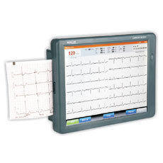
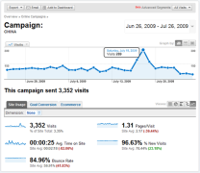
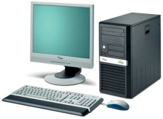

Phase I Architecture Stack
Modern Device
HTML5
Realtime Remote View
(Tablets, Phones, Workstations)
Modern Device
Legacy Device
Legacy Device
Analytics
Legacy Device
Web-based remote management
Other Gateway
Other Gateway
Hospital integration
Virtual or Physical Server; Linux (recommended) or Windows (if desired)
All services can run on a single “collapsed” server or distributed when scalability required
Data Logger (Syslog)
Data Distribution Service (DDS)
XMPP and REST Web Services
Remote Servicing (3rd Party) Wrapper Services
MongoDB and MySQL Databases
Websockets Service
Serial / RS232 Connectivity
DDS Subscribers
XMPP Nodes
Mirth/Mule HL7, ETL, Notifications
Apache Web Server, PHP, Ruby, CMS
Esper Complex Event Processor

Slide 26
Data-generator
Listens on a pre-defined port to accept connection from publisher.
Used to generate random data according to the command received from publishers

Slide 27
Data-generator
Data generator supports three commands BP (BloodPressure), pulseox (Pulseox) and Temp (Temperature monitor).
To run the data-generator use the following command binaries folder
#. /data-generator

Slide 28
Logging for Publisher and Subscribers
Publishers and subscribers have separate configuration files.
We can pass the configuration file as argument to the publishers and subscribers.
We can select the category via command line argument.
Major two categories are info and data. Info category has errors, warnings, notices and info. Data category has only formatted data.

Slide 29
Logging for Publisher and Subscribers
Example config for blood pressure publisher
log4j.category.bp.info=NOTICE, bpInfo
log4j.category.bp.data=INFO, bpData
log4j.appender.bpInfo=org.apache.log4j.FileAppender
log4j.appender.bpInfo.fileName=/var/log/netspective/bp/pub.bp.info.log
log4j.appender.bpInfo.layout=org.apache.log4j.PatternLayout
log4j.appender.bpInfo.layout.ConversionPattern=%d %-5p %c - %m%n
log4j.appender.bpData=org.apache.log4j.FileAppender
log4j.appender.bpData.fileName=/var/log/netspective/bp/pub.bp.data.log
log4j.appender.bpData.layout=org.apache.log4j.PatternLayout
log4j.appender.bpData.layout.ConversionPattern=%m%n
We can pass the category names (bp.info, bp. data ) as command line options
to all the publishers and get the pattern and filename to write the data or info.

Slide 30
Logging for Publisher and Subscribers
Example config for blood pressure subscribers
log4j.category.bp.info=INFO, bpInfo
log4j.category.bp.echo=INFO, bpEcho
log4j.category.bp.alarm=INFO, bpAlarm
log4j.category.bp.persist=INFO, bpPersist
It is a common configuration file for the all the blood pressure subscribers.
All the subscribers (echo, alarm and persist) has common info file and each one has separated data files.

Slide 31
Publishers
Publisher sends the command to the data generator and receive the sample data.
Receives the sample data as a single string with “:” as field separator.
Received string will be separated and used to populate the object.
Populated will be written to a DDS topic

Slide 32
Publishers
Sample Data (BP) received from Data generator
1319793289:132:71:66
Populated Object content
TimeStamp - 1319793289
Systolic Pressure – 132
Diastolic Pressure - 71
Pulse Rate - 66

Slide 33
Publishers
Command Line options for
# ./bp-pub
Available options for are:
--help produce help message
--data-gen-ip arg Data Generator IP
--data-gen-port arg Data Generator Port
--domain arg Device Domain
--device-id arg Device ID - for device identification
--log-info arg Log Info Specification
--log-data arg Log Data Specification
--log4cpp-conf arg Log Configuration and Format specification file

Slide 34
Publishers
Example to Running publishers
#./bp-pub --data-gen-ip 127.0.0.1 --data-gen-port 5000 \
--domain bp --device-id BP_LAB3 --log-info bp.info \
--log-data bp.data --log4cpp-conf \ ../src/c++/production/conf/simulation_log_bp.conf
We will receive notices, errors and warnings in the file
/var/log/netspective/bp/pub.bp.info.log
and formatted data in the file
/var/log/netspective/bp/pub.bp.data.log

Slide 35
Spawn the Publisher
Shell script to spawn publisher which starts multiple publishers at the same time
Command line options for shell script
# ./bp-pub.sh
USAGE:
BloodPressure Publisher
OPTIONS:
--domain Device Domain
--device-id Device ID to identify the particular device
--spawn Number of publishers to run
--log4cpp-conf Importing log4cpp configuration
EXAMPLE:
# ./bp-pub.sh --device=bp --device-id=A10 --spawn=15 \
--log4cpp-conf ../src/c++/production/conf/simulation_log_bp.conf

Slide 36
Subscribers
Subscriber Types : Echo, Alarm and Persist.
Echo - Get the published data and display
Persist - Get the published data and stores in database.
Alarm - Get the published data and display the abnormal behavior only.

Slide 37
Subscribers
Common command line options for all subscribers
# ./<device-type>-sub-<type> {command line options}
Available options for <<Device Type> Publisher> are:
--help Produce help message
--domain Device Domain
--device-id Device ID - for device identification
--log-info arg Log Info Specification
--log-data arg Log data Specification
--log4cpp-conf arg Log Configration and Format specification file

Slide 38
Subscribers
Command line options for alarm subscribers(other than common)
For blood Pressure Alarm
--systolic-low arg Systolic Low Pressure Alarm Specification - default <90
--systolic-high arg Systolic High Pressure Alarm Specification – default >140
--diastolic-low arg Diastolic Low Pressure Alarm Specification - default <60
--diastolic-high arg Diastolic High Pressure Alarm Specification – default >90
--pulse-rate-low arg Pulse Low Rate Alarm Specification - default <60
--pulse-rate-high arg Pulse High Rate Alarm Specification - default >90
For pulse oximeter alarm
--spo2-low arg SPO2 Low level Alarm Alarm Specification - default <88
--spo2-high arg SPO2 High Level Alarm Specification - default >92

Slide 39
Subscribers
For temperature monitor
--avg-time-period arg Average time period for temperature - default 1 min
--temp-low arg Temperature Low level Alarm Specification - default <88
--temp-high arg Temperature High Level Alarm Specification - default>92

Slide 40
Subscribers
Example to run subscribers
# ./bp-sub-echo --domain bp --device-id BP_LAB3 \
--log-info bp.info --log-data bp.echo --log4cpp-conf \ ../src/c++/production/conf/simulation_log_bp_sub.conf
We will receive subscribers notices, errors and warnings in the file /var/log/netspective/bp/ sub.bp.info.log and formatted data will stored in the sub.<echo/alarm/persist>.bp.data.log in the same path

Slide 41
Webserver
Common command line options for all subscribers-webserver
# ./web-listener {options}
Available options are :
--web server name Webserver Name
--port_no Port Number

Slide 42
Webserver
./web-listener netspective-webserver.com 9003
Argument one for hostname of the webserver to listen.
Argument two for port number of the webserver to listen.

Slide 43
Web server
URL to access the data
http://netspective- webserver.com/medigraph/index.php?domain_i d=DOMAINID&device_id=DEVICEID
Note:
If domain name and device id are missed then entire device data will be displayed ..

Slide 44
ECGSyn
ECGSyn is a tool available in Physionet which generates digital data to create ECG waveform data
ECGSyn takes number of parameters based on which the digital data was generated

Slide 45
ECGSyn Sample Input Parameter
n Approximate number of heart beats 256
s ECG sampling frequency [Hz] 256
S Internal Sampling frequency [Hz] 256
a Amplitude of additive uniform noise [mV] 0
h Heart rate mean [bpm] 60
H Heart rate standard deviation [bpm] 1
f Low frequency [Hz] 0.1
F High frequency [Hz] 0.25
v Low frequency standard deviation [Hz] 0.01
V High frequency standard deviation [Hz] 0.01
q LF/HF ratio 0.5
R Seed 1

Slide 46
ECGSyn Sample Data
Based on the sample input parameters, ECGSyn generates 53.12 MB of data in 7min 50Secs which is pushed to DDS through Publisher
Subscriber fetch 52.11 MB of data from DDS during the same period

Slide 47
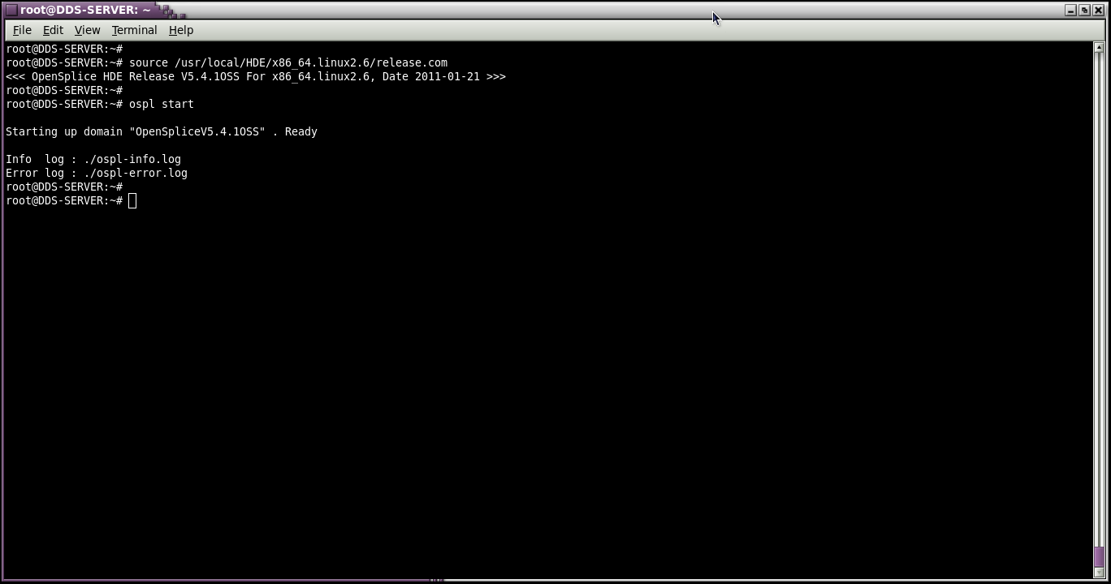
Starting Up DDS Server

Slide 48
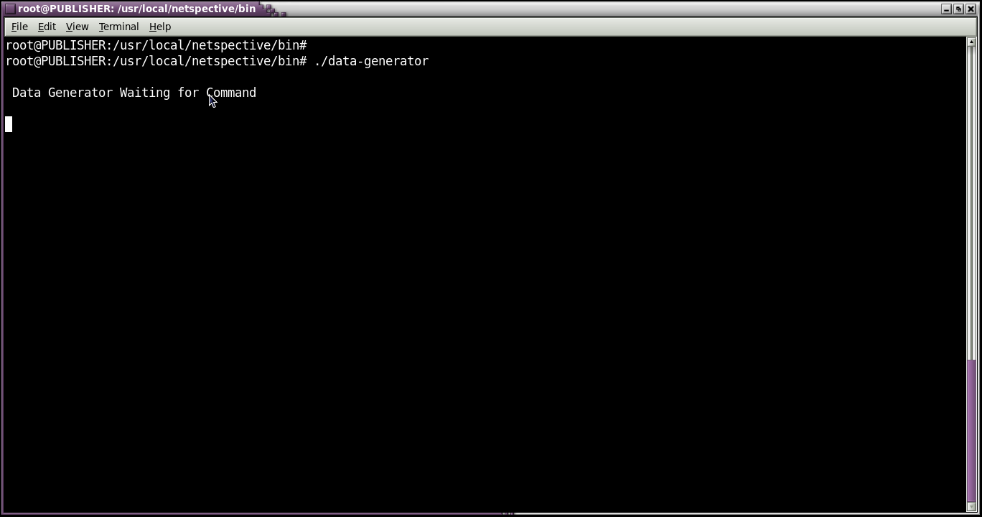
Running Data-Generator

Slide 49
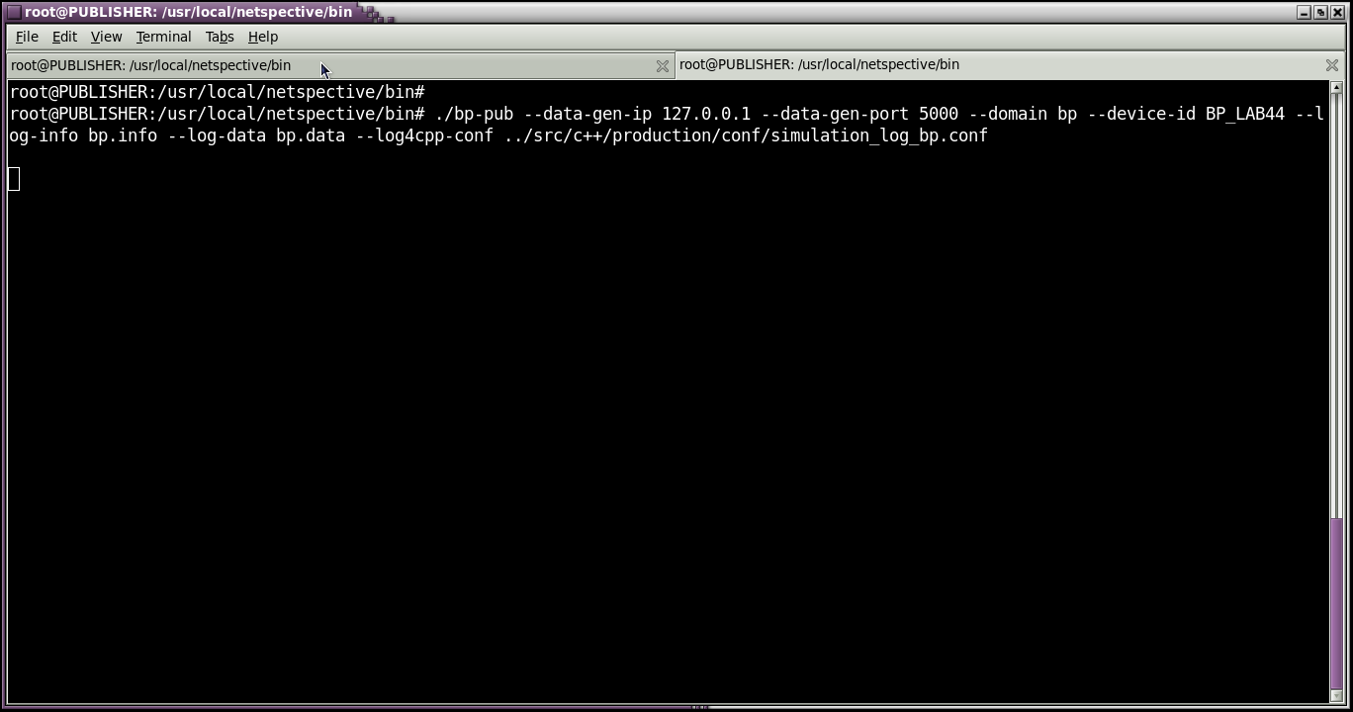
Running BP Publisher

Slide 50
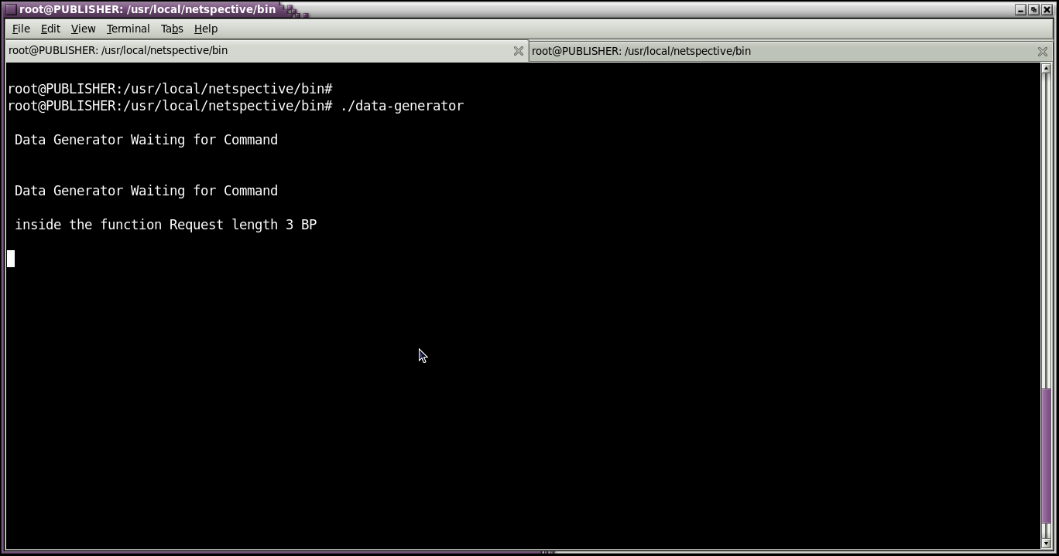
Data-Generator Gets the Commands

Slide 51
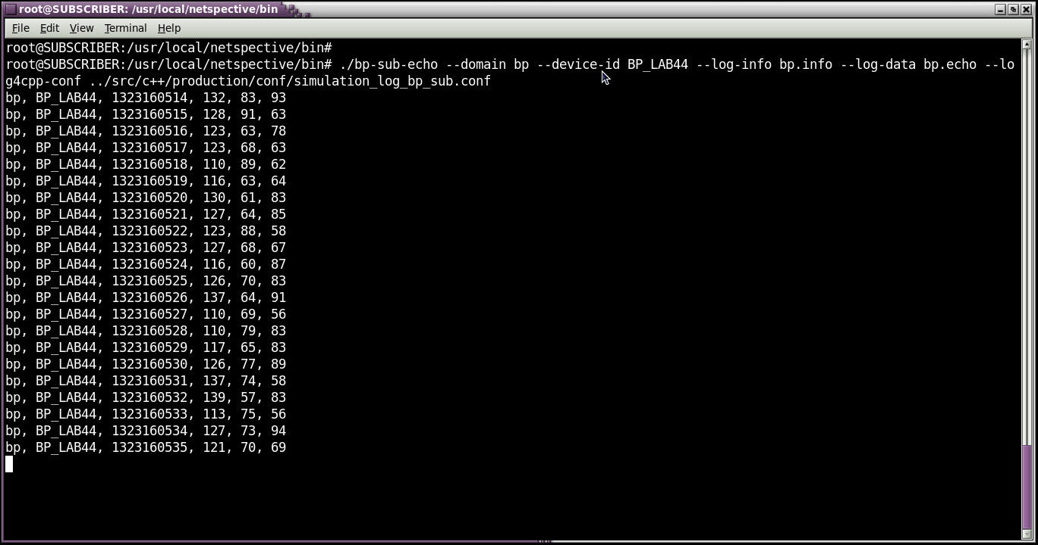
Running Echo Subscriber

Slide 52
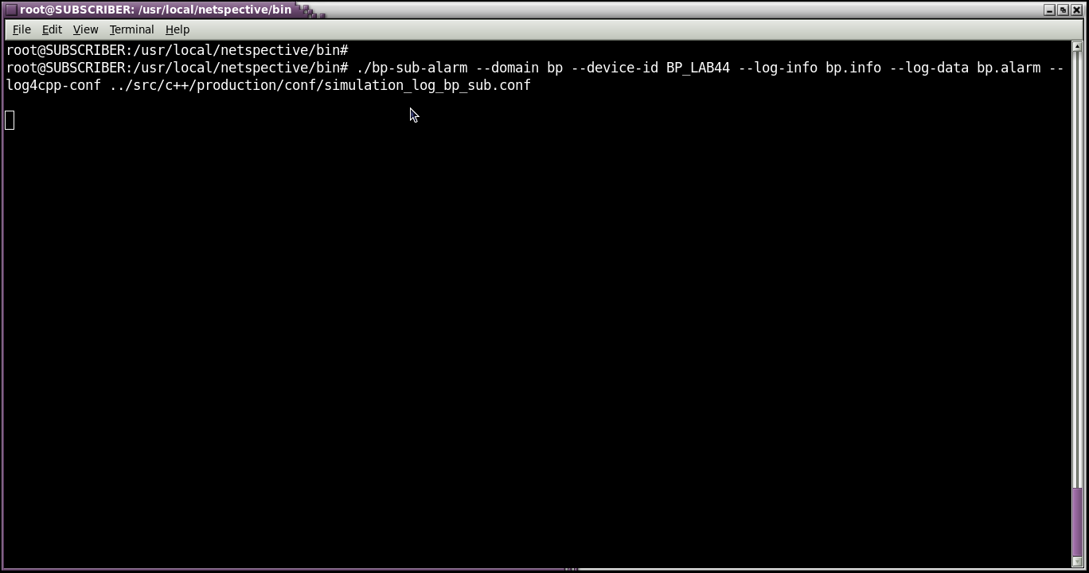
Running Alarm Subscriber

Slide 53
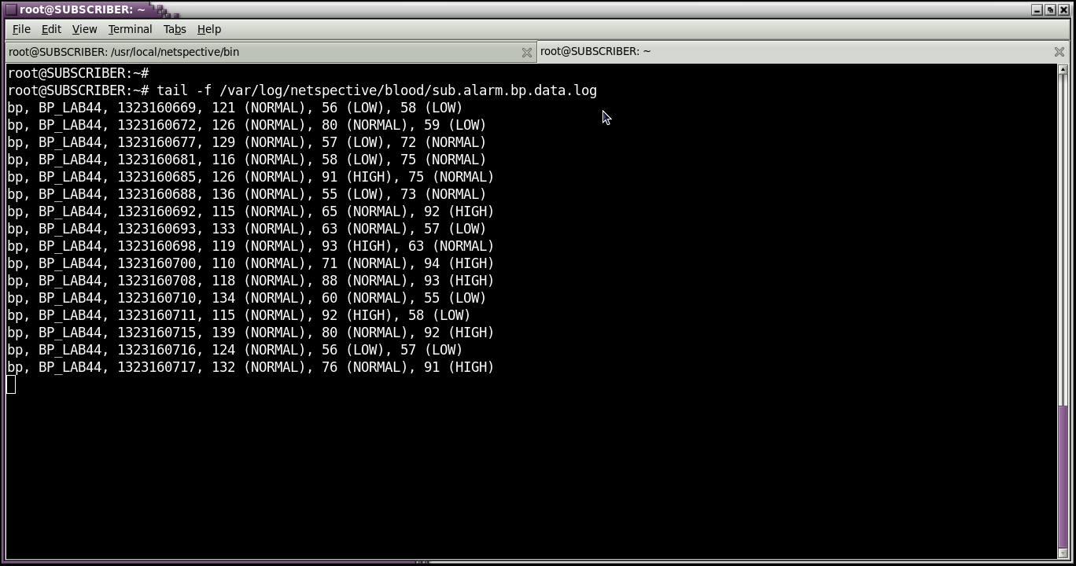
Alarm Subscriber Logging

Slide 54
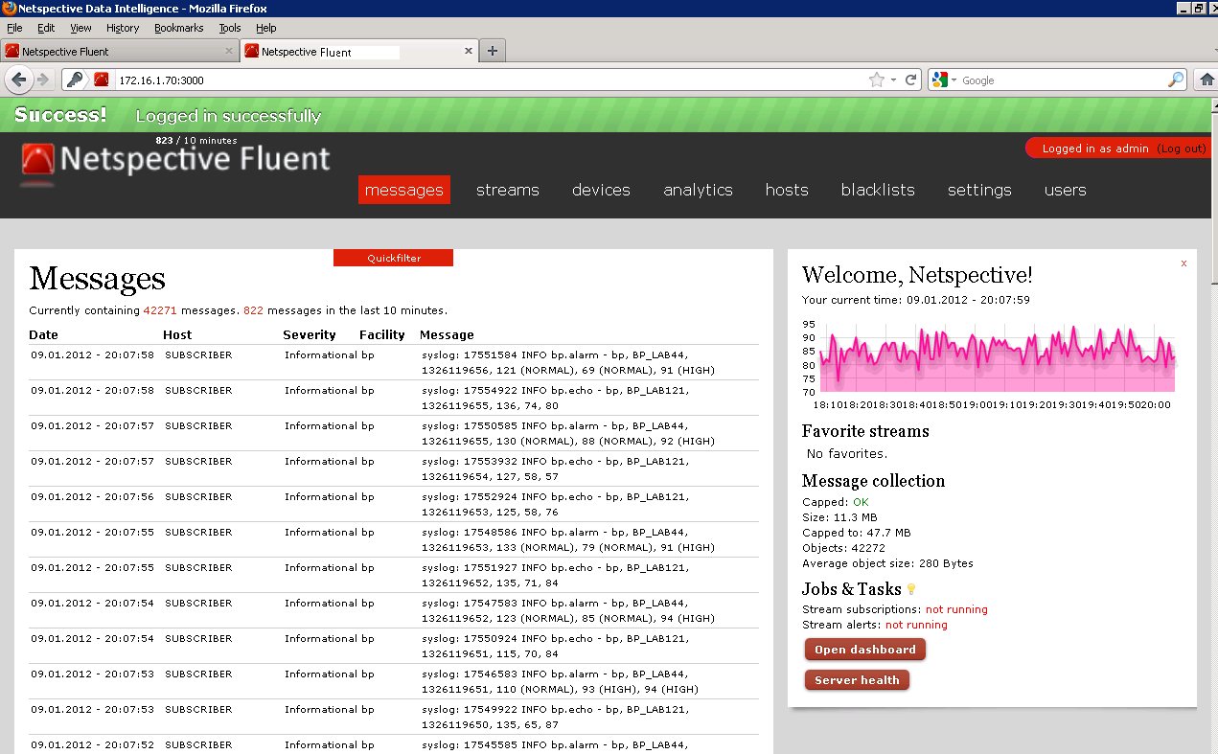
NetspectiveDI Log Capturing

Slide 55
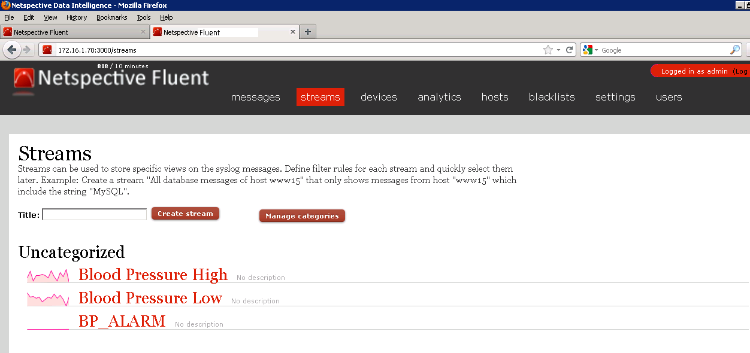
Streams

Slide 56
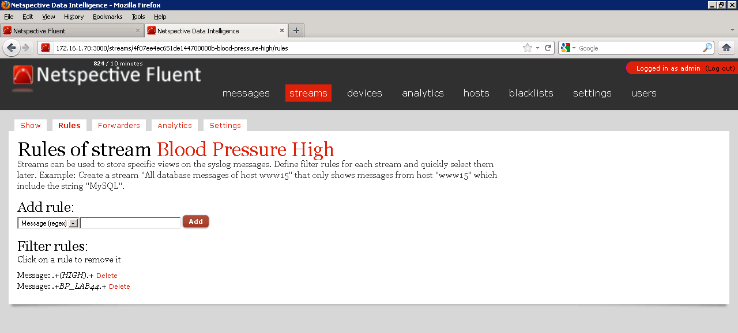
Rules for the Blood Pressure HIGH

Slide 57
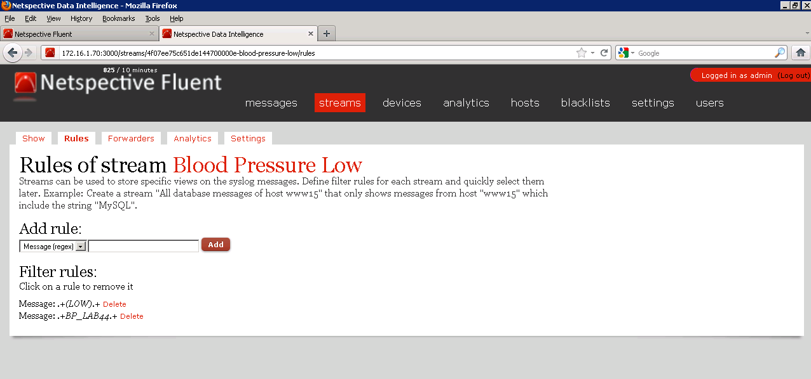
Rules for the Blood Pressure Low

Slide 58
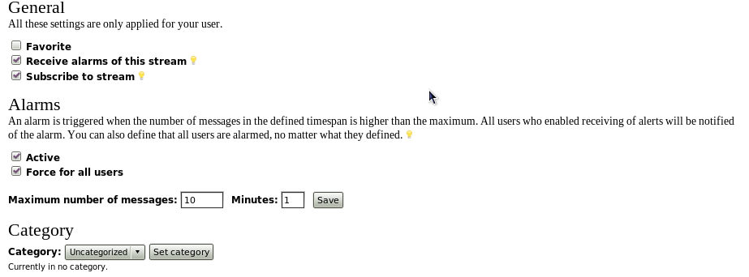
Setting for Both Streams

Slide 59
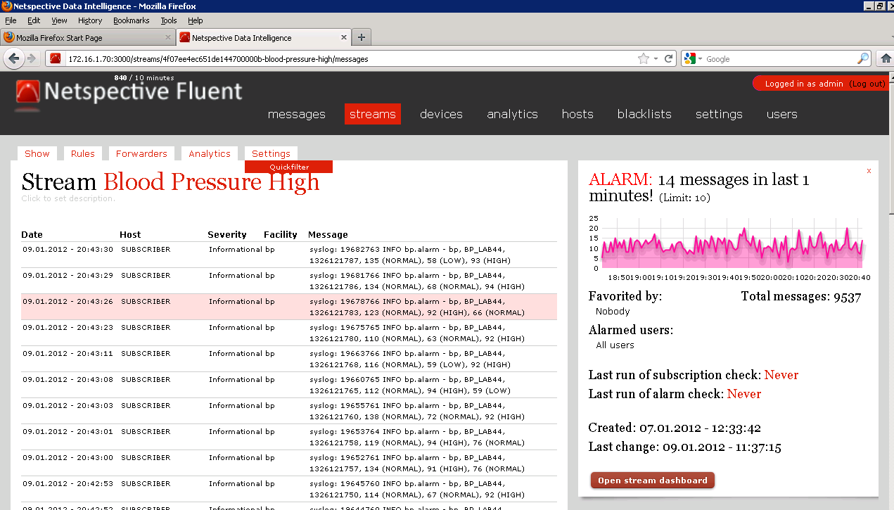
Blood Pressure Stream High

Slide 60
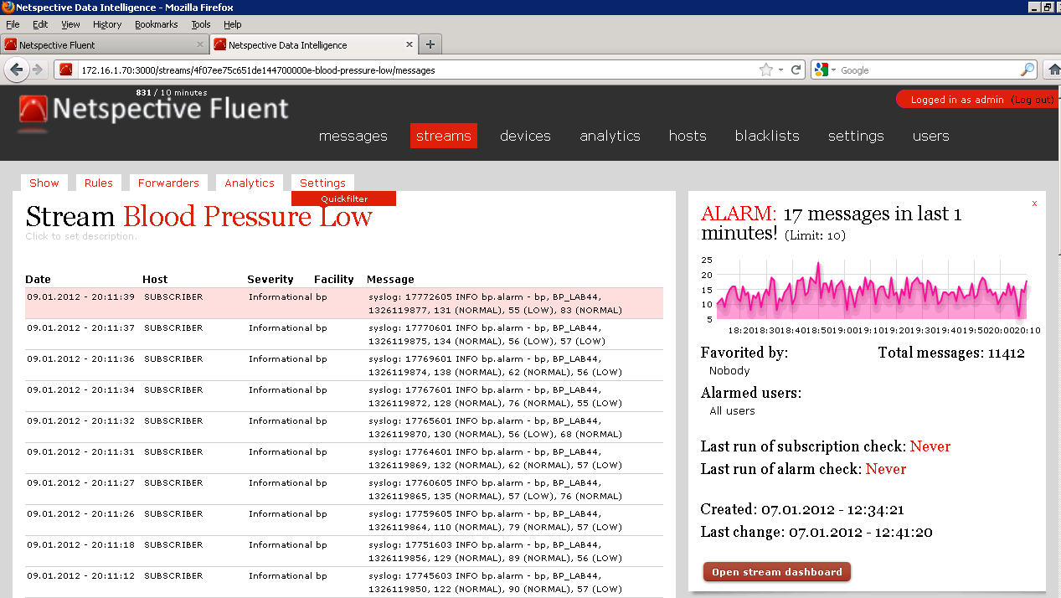
Blood Pressure Stream Low

Slide 61
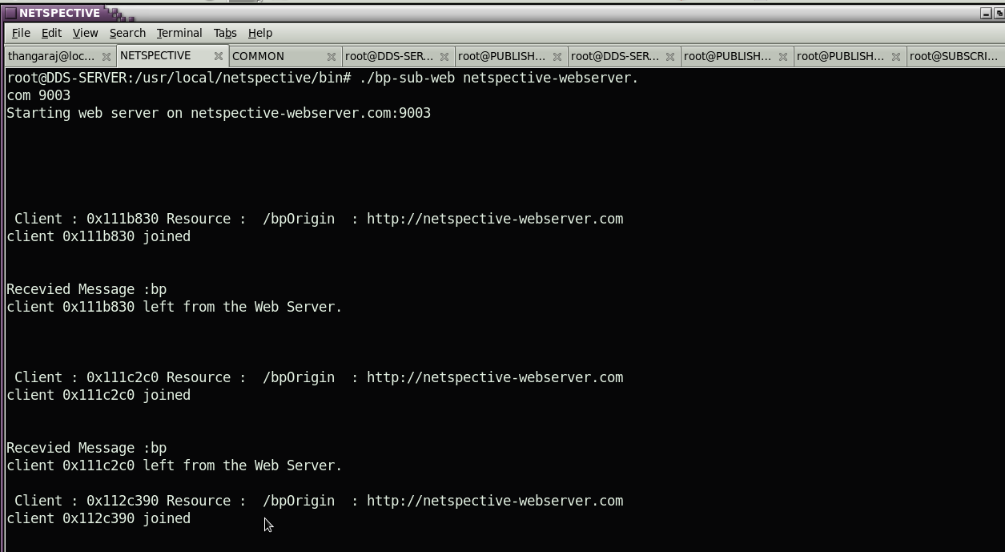
Web server

Slide 62
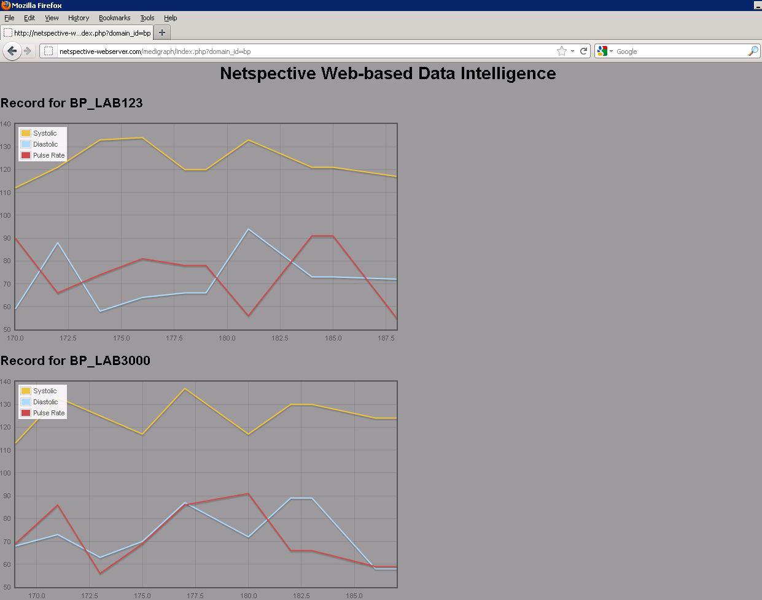
Web server

Slide 63
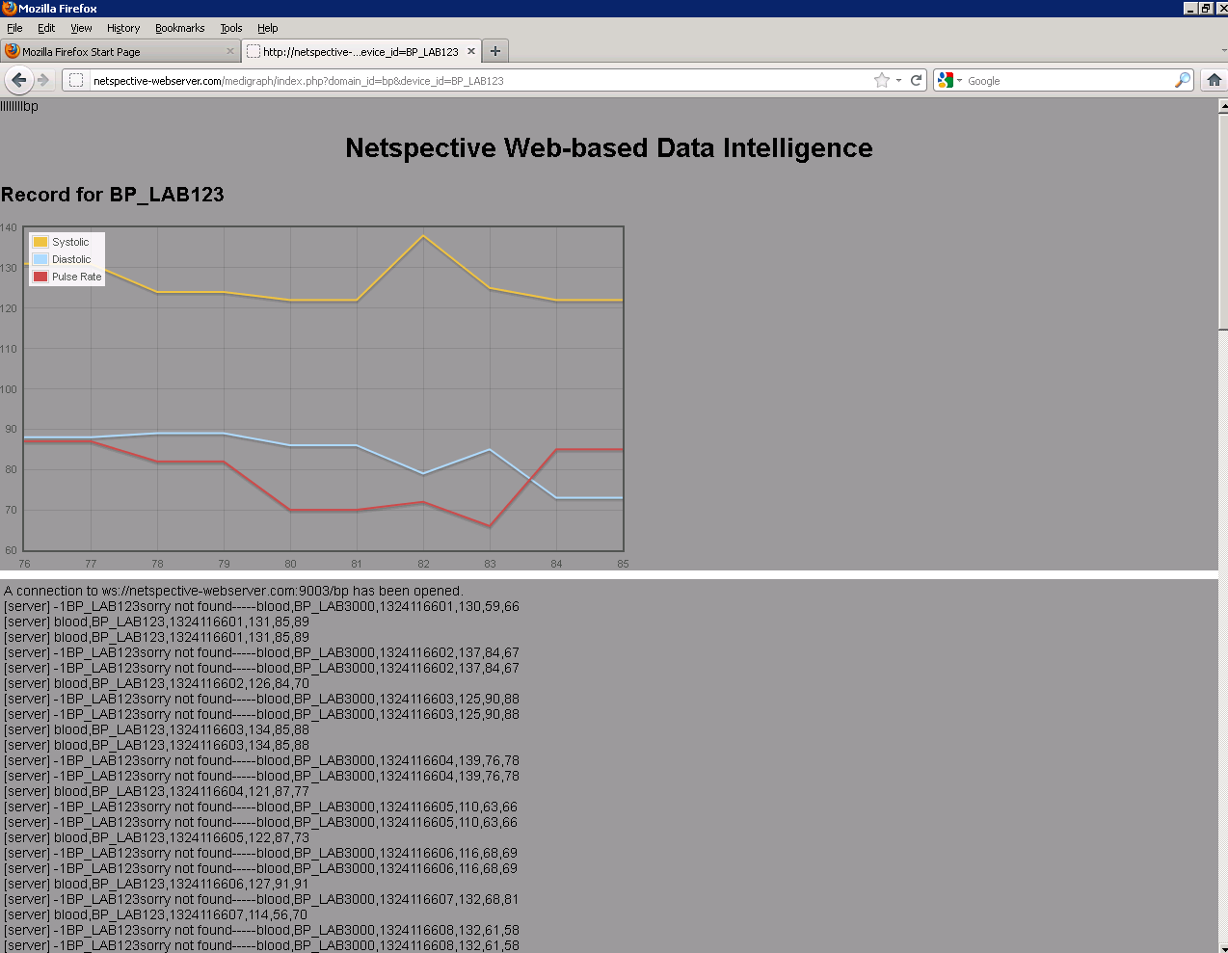
Web server

Slide 64
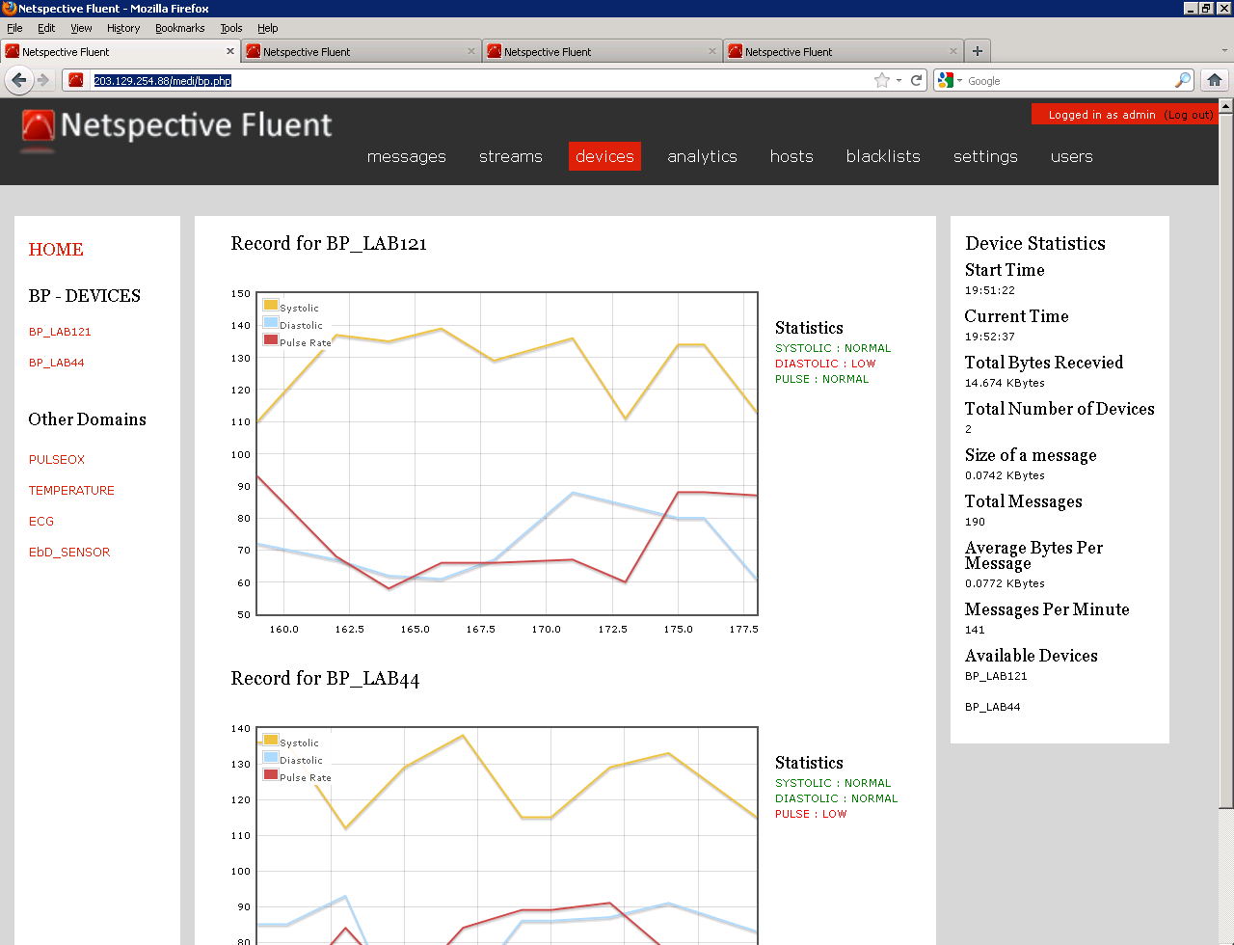
Netspective Fluent -BP

Slide 65
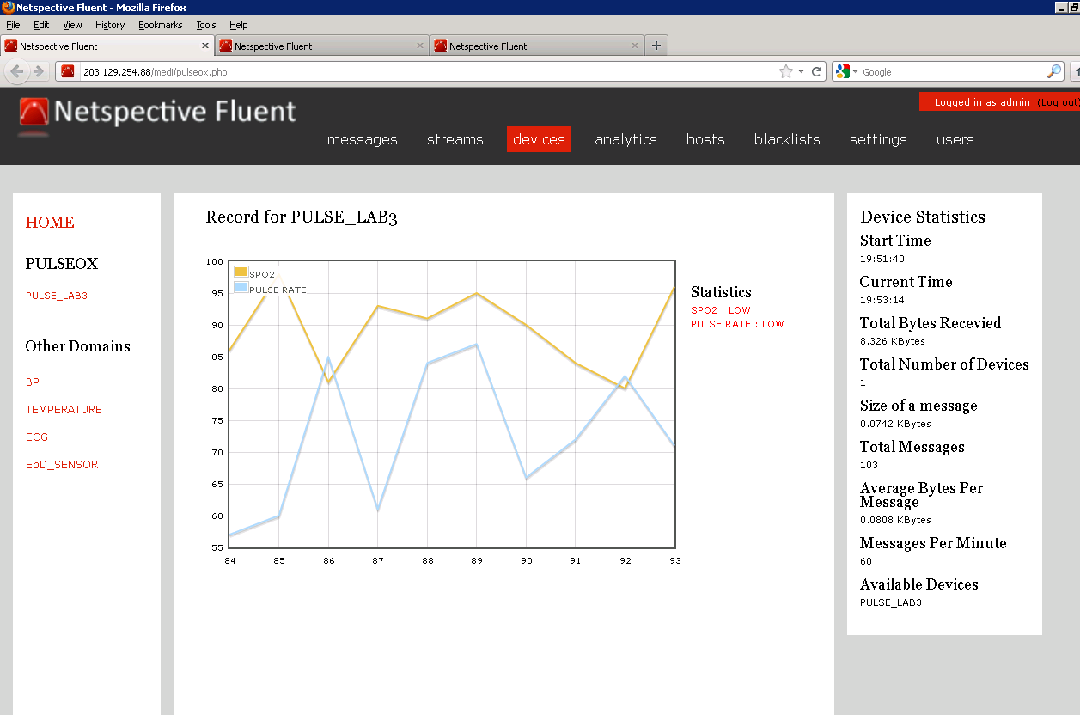
Netspective Fluent- Pulseox

Slide 66
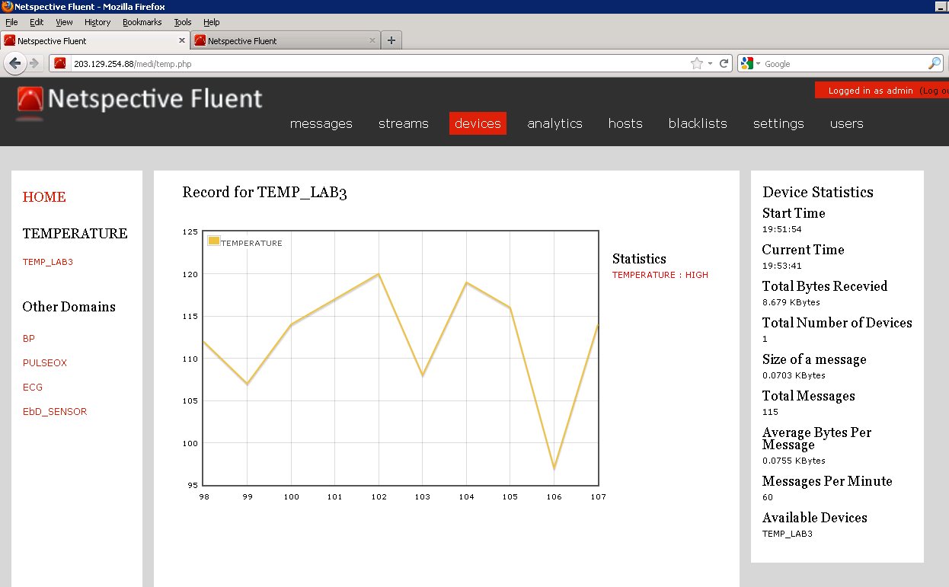
Netspective Fluent-Temperature

Slide 67
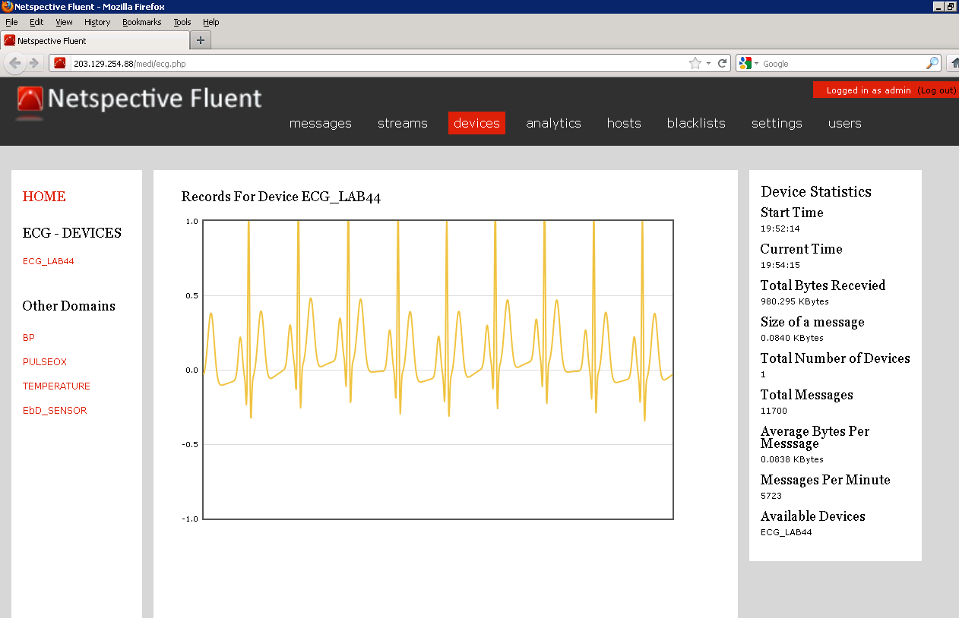
Netspective Fluent – ECG

Slide 68
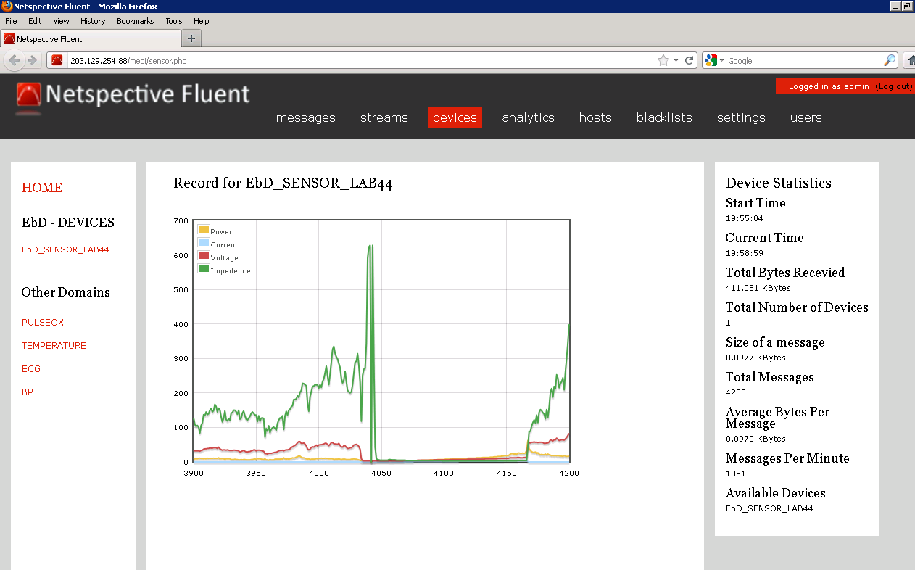
Netspective Fluent – EbD Sensor

Slide 69
Ongoing Enhancements
Common persistent subscriber.
Implementation with Multiple Gateway
Making DDS real-time, Synchronize the data-writer and data-reader.

Slide 70
Questions

